Slide 1
Semantic Analysis of Midterm Election Candidates
Kyle Arbide, Asare Buahin and Katherine Asianah

Slide 2
Our Pilot Data
Congressional records
Tweets from our identified sample of midterm candidates.
News appearances, speeches and debates as additional data through the YouTube API
Candidate Websites

Slide 3
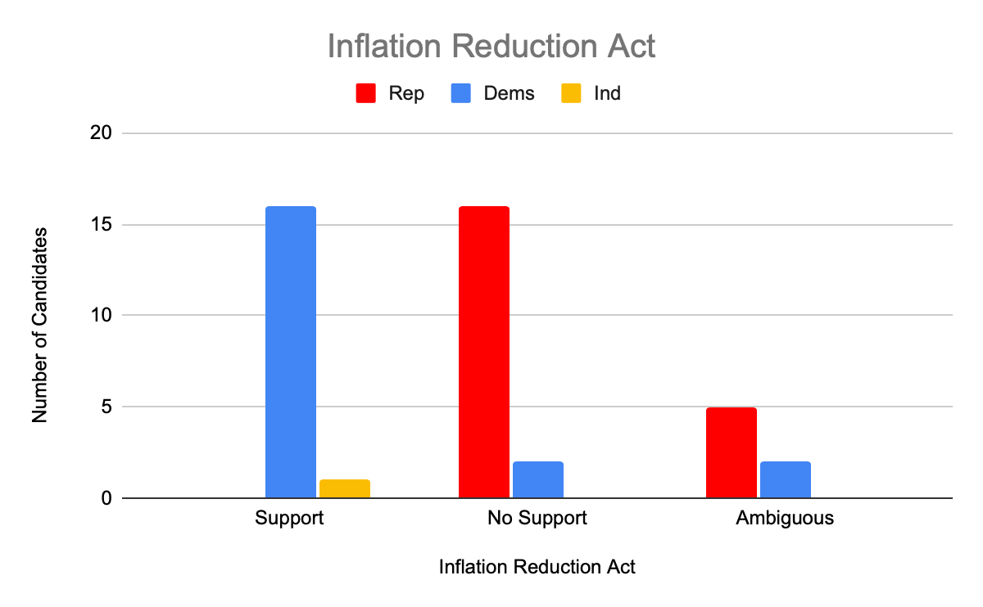
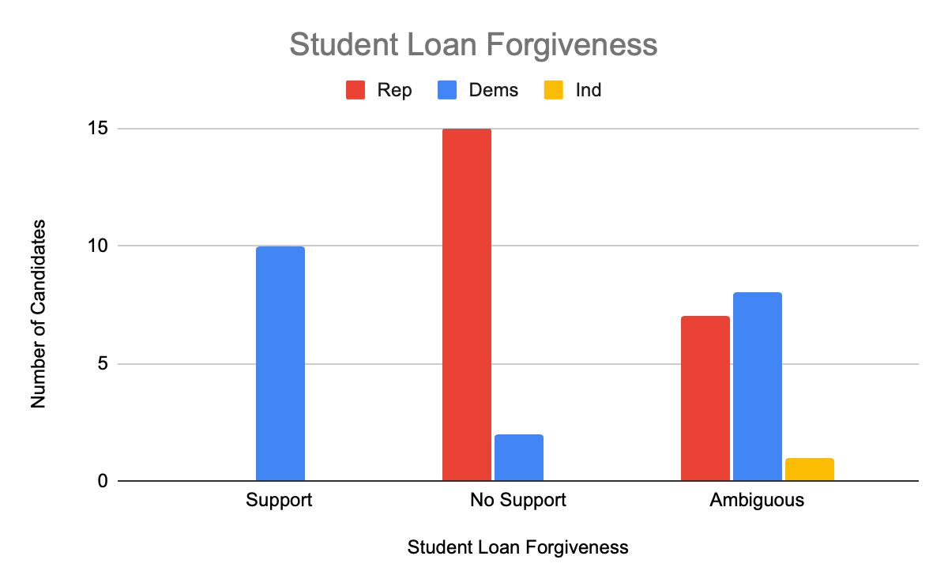
Descriptive Statistics
Fig 1: Distribution of Stance Support by Party
Support: Clear, vocal support from candidates about policy
No support: Criticized and disagree with policy
Ambiguous: No clear stance or previously had a strong opinion but has been silent in recent times.

Slide 4
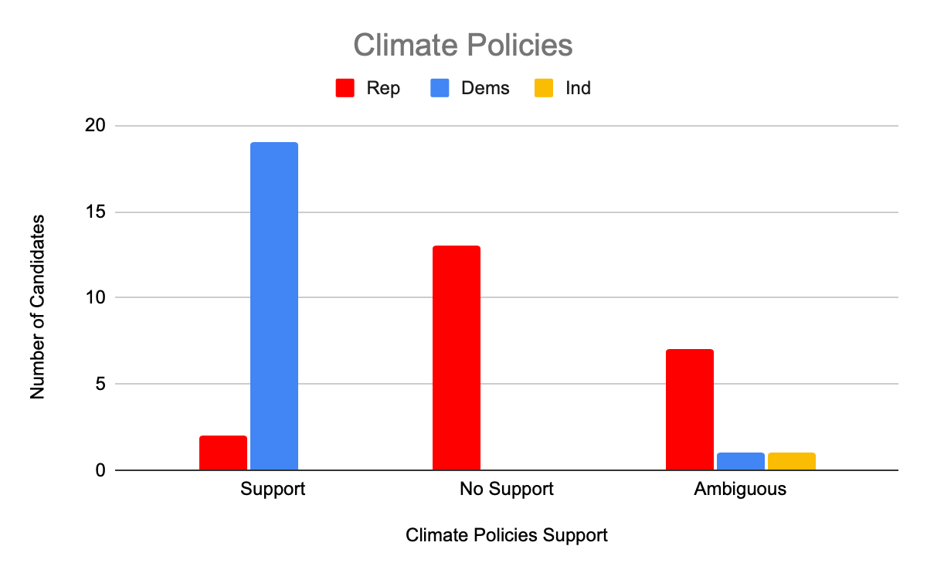
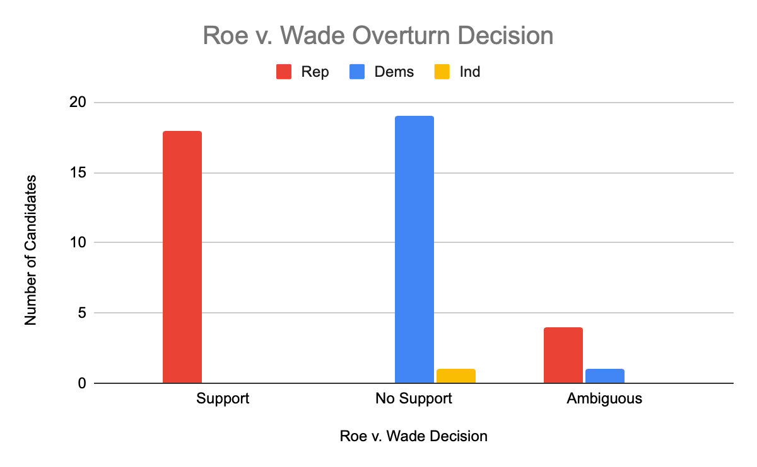
Descriptive Statistics
Fig 2: Distribution of Stance Support by Party

Slide 5
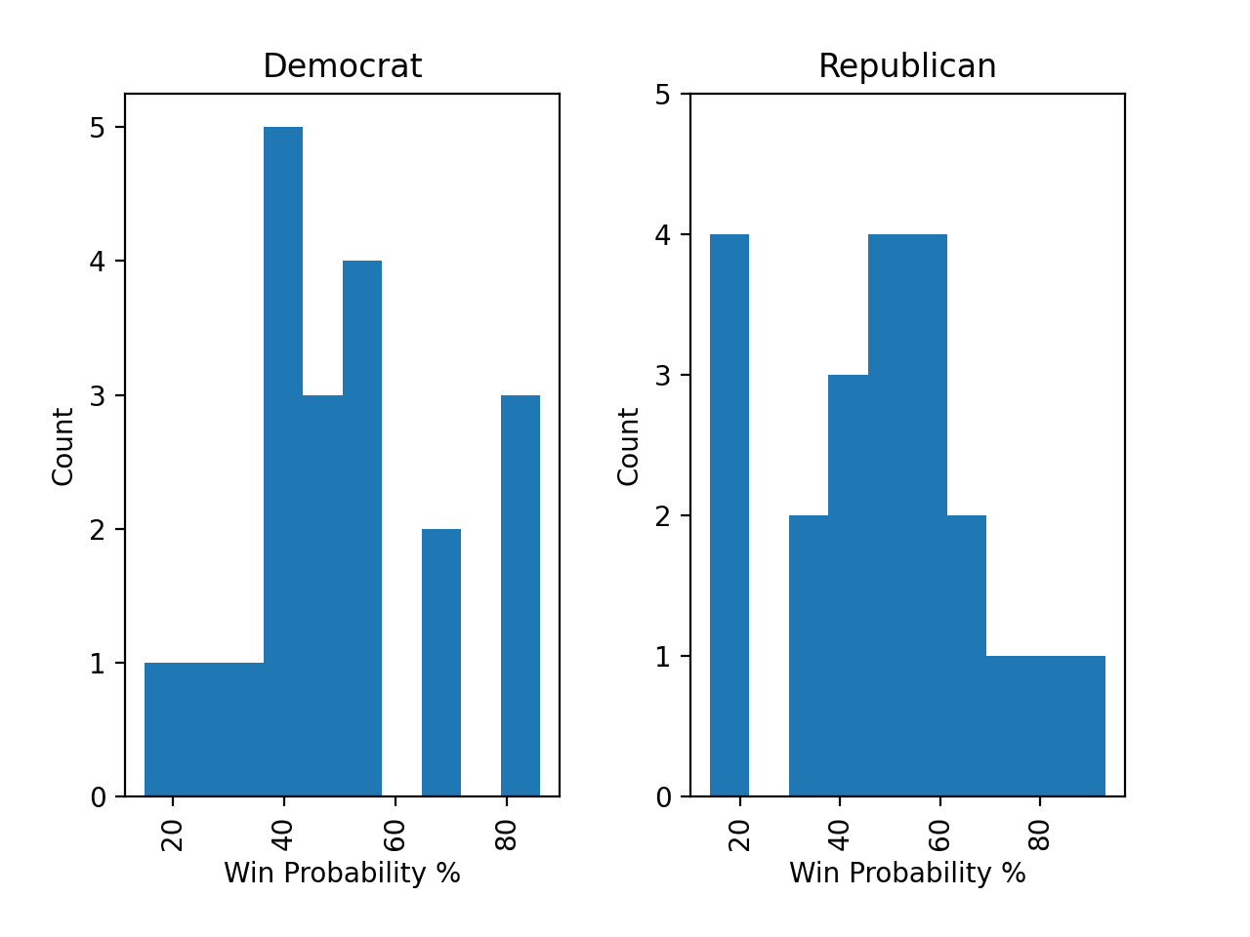
Descriptive Statistics
Fig 3: Win probability by party
*Source: FiveThirtyEight
*One Independent candidate from Utah has a 7% chance of winning

Slide 6
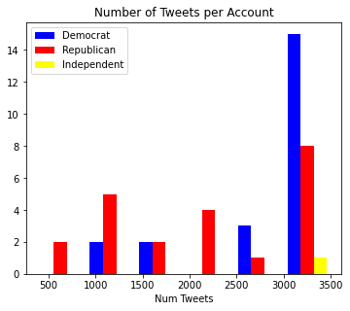
Descriptive Stats Cont.
Majority of our Candidates have >3000 tweets
Number of tweets we can pull from one account capped at 3500 per call

Slide 7
Unit of Analysis
Our unit of analysis is a political candidate running in close elections for the upcoming midterm election.
We have defined close elections as elections where the projection model gives the favorite less than a 90% chance to win. (fivethirtyeight.com)
We’re more interested in how candidates approach these topics in close elections as they are more strategy involved in how they dictate their opinions
Notes:
What is your unit of analysis? Why? • We discussed this last time, but now rethink it based on your sampling plan.
Unit of Analysis is the individual thing that you are studying. A “sample” in ML terms.

Slide 8
Population
Theoretical Population
Accessible Population
Every political candidate who has run/is running in upcoming midterm elections for a house or senate position in the USA.
Political candidates who are running for office in the upcoming midterm elections based on our selection criteria.
This is because political candidates in the upcoming elections will be debating these issues and will have to take a stance.
Notes:
Theoretical Population: To whom do you want to generalize?
Maybe our theoretical population is all house and senate politicians since they are the ones discussing the issues
Accessible Population: What population can you access?
And then our accessible population is those candidates running in this election since they are actively debating and speaking opinions on these issues?
Its tough because Im not sure who we want to generalize
In theory maybe these are the same because there really isn’t any reason we cant access the candidate speech data
So instead theoretical and accessible is all political candidates for this election cycle?

Slide 9




Sampling Frame & Size of Sample
Tweets collected through candidate usernames
Queried Youtube searches for public appearances and speeches.
>100,000 tweets dating back to March 2021
Congressional Records parsed using NER (Named Entity Recognition)
Sample Size
43 candidates in 21 different elections
31 congressional records between July 7- September 7
Notes:
What is the sampling frame that will you use to select your sample? Why?
We’re accessing these candidates speeches through:
Twitter and Youtube data through candidate usernames
Congressional Records parsed using NER (Named Entity Recognition).
Queried Youtube searches for public appearances and speeches.
How large will your sample be? Why?
43 -candidates
~100,000 tweets dating back to March 2021
31 congressional records between July 7- September 7

Slide 10
Threats to External Validity
Sample Selection
Focused on close elections, meaning we cannot make any claims regarding Landslide elections
Data Collection
We are limited to the data we can get from Twitter, Youtube and Congressional Records.
Captioning from Youtube may be incorrect or out of scope
Time Frame
Our study cannot be generalized over time. These issues have particular relevance for this election cycle
Politicians may take on new positions.
Notes:
A threat would be the text data that we don’t use outside of these 3 source

Slide 11
Sampling Strategies
Nonprobability
Purposive
Our candidates were handpicked. Preference to Senate races as they are higher profile
Our selection criteria is elections where the favorite has <90% chance to win. Allows us to target candidates with selective rhetoric and to contrast competitors.
Notes:
Probability or Nonprobability sampling?
We used non probability sampling
We chose close senate elections and then randomly filled out the dataset with close house elections
Final dataset: Sample of 21 elections and 43 candidates (Alaska has 3 candidates)
What sampling strategy was used?
We used purposive sampling
Specified a specific criteria for elections/candidates that we were interested in
We’re more interested in how candidates approach these topics in close elections as they are more strategy involved in how they dictate their opinions.

